Slide 1
Chapter 8: Simple Linear Regression
Part 4

Slide 2
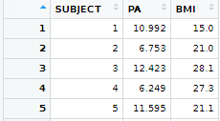
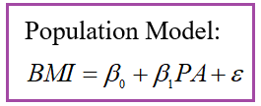



Relationship between BMI and physical activity (sample: 100 undergraduate students, PABMI)

Slide 3
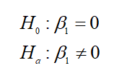
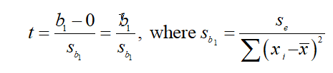

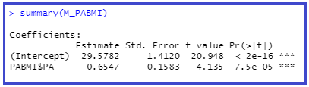

Significance Test for Population Model Slope

Slide 4

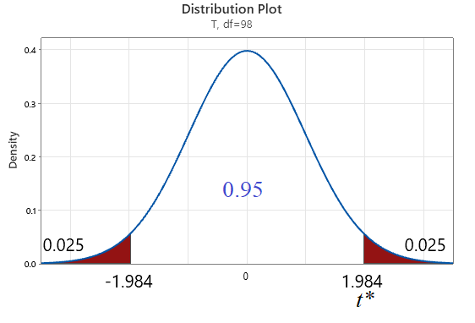



Confidence Interval for Slope
The confidence interval is:
b₁ ± t* S_{b1}

Slide 5

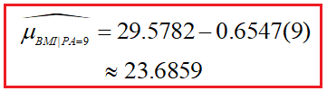


Point Estimates for a given x*

Slide 6



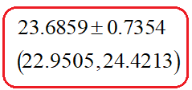

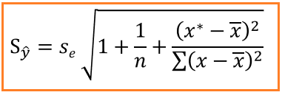
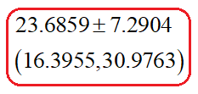

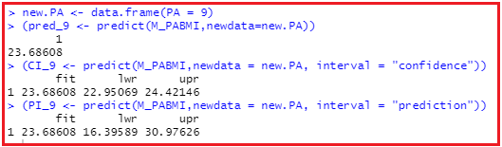
Confidence Interval (CI) for Mean Response, PA = 9 Prediction Interval (PI) when PA = 9

Slide 7
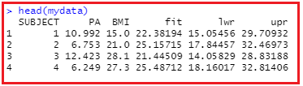
Scatterplot, bounds for CI,PI
pred.int <- predict(M_PABMI,interval = "prediction")
mydata <- cbind(PABMI,pred.int)
(Could have added to PABMI dataframe but decided not to.)
p <- ggplot(mydata,aes(x=PA, y = BMI))+
geom_point(color = "black", size = 3)+
geom_smooth(method = "lm", color = "blue")
p + geom_line(aes(y=lwr), color = "red", linetype = "dashed")+
geom_line(aes(y=upr), color = "red", linetype = "dashed")

Slide 8
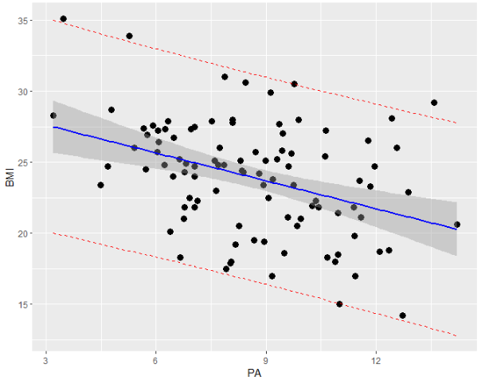
ggplot

Slide 9

Goal: Prediction
Partition PABMI dataset into training and testing datasets.
set.seed(107)
inTrain <- createDataPartition(y=PABMI$BMI, p=.7, list = FALSE)
y = PABMI$BMI is the response or target variable
p = proportion of records in the training set
list = FALSE keeps results in a vector for easy access.
str(inTrain)
PABMI.train <- PABMI[inTrain,]
PABMI.test <- PABMI[-inTrain,]
summary(PABMI.train)
summary(PABMI.test)

Slide 10
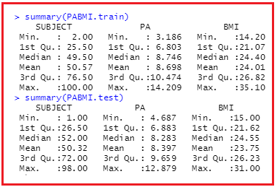
Output from summary command

Slide 11
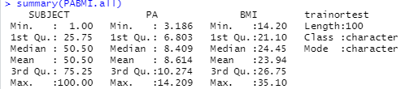
Kruskal-Wallis test: Are medians of PA and BMI significantly different between training and testing datasets? (We don’t want that! Want to make sure testing and training sets are similar. If not, need to repartician the data.)
Check Assumptions:
1. Groups are independent.
We randomly selected the training and testing datasets. So, this is satisfied.
2. Distributions of variables are similar across the groups.
Needs some work before we can proceed. (Look back at previous slide.)
PABMI.train$trainortest <- rep("train", nrow(PABMI.train))
PABMI.test$trainortest <- rep("test", nrow(PABMI.test))
PABMI.all <- rbind(PABMI.train,PABMI.test)
summary(PABMI.all)

Slide 12
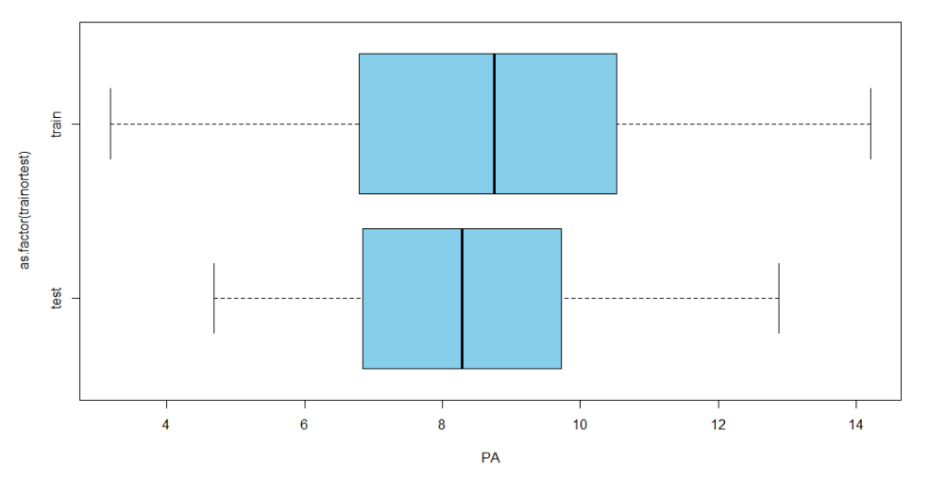
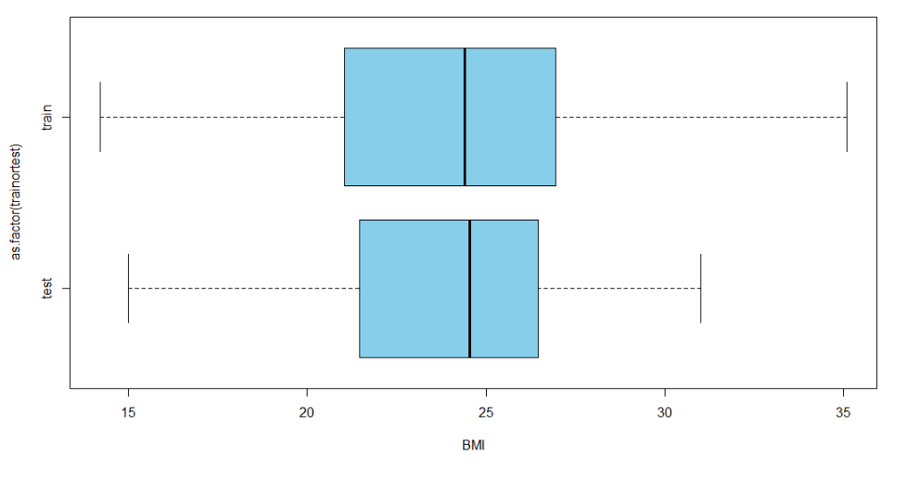
Compare distributions of training and testing data
boxplot(PA~as.factor(trainortest), data = PABMI.all, horizontal = TRUE, col = "skyblue")
boxplot(BMI~as.factor(trainortest), data = PABMI.all, horizontal = TRUE, col = "skyblue")

Slide 13

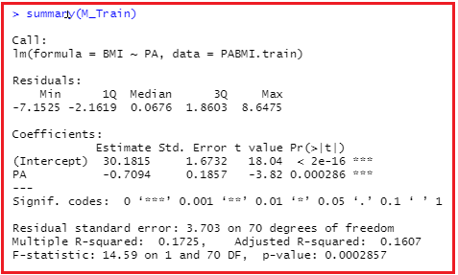
Kruskal-Wallis test, all I need are p-values
kruskal.test(PA~as.factor(trainortest), data = PABMI.all)$p.value
kruskal.test(BMI~as.factor(trainortest), data = PABMI.all)$p.value
p-values above 0.05, fail to reject null hypothesis: medians are the same.
(M_Train <- lm(BMI~PA,data = PABMI.train))

Slide 14
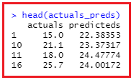


How accurate are the predictions?
BMIpred <- predict(M_Train,newdata = PABMI.test)
actuals_preds <- data.frame(cbind(actuals=PABMI.test$BMI,
predicteds=BMIpred))
Calculate Min_Max accuracy. The higher the better.
min_max_accuracy <- mean(apply(actuals_preds,1,min)/ apply(actuals_preds,1,max)) min_max_accuracy
Calculate MAPE: The lower the better.
mape <- mean(abs((actuals_preds$predicteds-
actuals_preds$actuals))/actuals_preds$actuals)
mape

